Slide 1
KN
Hypersense

Slide 2
Agenda
The project
Smart Factory
Demo
Notes:
Agenda Title Font: Arial bold 36pt white Agenda Item Font: Arial bold 18pt white

Slide 3
02
01
KN Hypersense
Main title, Arial bold 36pt
Subtitle, Arial regular 24pt
Notes:
Number Font: Arial bold 180pt white Key Message Font: Arial bold 36pt white Body Text Font: Arial 24pt white

Slide 4



























IOT Ecosytem
Applications
Smart Factory
Asset management
Fleet Management
Smart Contracts
Smart cities
…
Energy Management
Platforms
Device management
Integration endpoints
Real time analytics
Rules Engine
Storage
Big Data
Devices
Micro Controller Board
Single Board Computer
Network Gateway
Edge Server
Data Acquisition System
Sensors/Actuators
temperature
humidity
pressure
proximity
level
accelerometer
Optical
gyroscope
infrared
…
Notes:
Title Font: Arial bold 24pt KN Dark blue Body Text Font: Arial 18pt black

Slide 5
KN Hypersense
Applications
Smart Factory
Asset management
Fleet Management
Smart Contracts
Energy Management
Smart cities
…
Platforms
Device management
Integration endpoints
Real time analytics
Rules Engine
Storage
Big Data
Devices
Micro Controller Board
Single Board Computer
Network Gateway
Edge Server
Data Acquisition System
Sensors/Actuators
temperature
humidity
pressure
proximity
level
accelerometer
Optical
gyroscope
infrared
…
Smart Contracts
System On Module
Notes:
Title Font: Arial bold 24pt KN Dark blue Body Text Font: Arial 18pt black

Slide 6


Challenges for every IT role
Product Owner
Software Analyst
Frontend Developer
Software Analyst
Backend Developer
Backend Developer
Quality Assurance
Devops Engineer
Notes:
Title Font: Arial bold 24pt KN Dark blue Subtitle Font: Arial bold 18pt black Body Text Font: Arial 18pt black

Slide 7
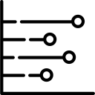

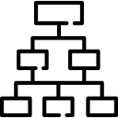

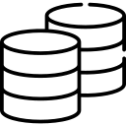









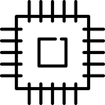

Technology challenges
Architecture
Analytics
Streaming
High Concurrency
High performances
Distributed System
Large Datasets
Analytics
Analytics
Big Data
Machine Learning
Data Visualization
Distributed Caches
Device management
Integration endpoints
Real time analytics
Rules Engine
Storage
Big Data
Integration
Protocols
Edge Server
Data Acquisition System
Hardware/Electronics
Sensors
Microcontroller Unit Board
Single Board Computer
Notes:
Analytics: Big data, Machine Learning, Microservices
Hardware/Electronics: Arial 18pt black
Integration: Large datasets, Streaming, Performances, High Throughput
Hardware/Electronics: Arial 18pt black

Slide 8















Technology Solutions
Architecture
Analytics
Analytics
Device management
Integration endpoints
Real time analytics
Rules Engine
Storage
Big Data
Integration
Protocols
RabbitMq
Kafka
Amazon SQS
Mosquitto
Californium
Edge Server
Data Acquisition System
Hardware/Electronics
Smart Contracts
System On Module
Single Board Computer
Notes:
Analytics: Big data, Machine Learning, Microservices
Hardware/Electronics: Arial 18pt black
Integration: Large datasets, Streaming, Performances, High Throughput
Hardware/Electronics: Arial 18pt black

Slide 9
Kn Hypersense Smart Factory
Applications
Smart Factory
Asset management
Fleet Management
Smart Contracts
Energy Management
Smart cities
…
Platforms
Device management
Integration endpoints
Real time analytics
Rules Engine
Storage
Big Data
Devices
Micro Controller Board
Single Board Computer
Network Gateway
Edge Server
Data Acquisition System
Sensors/Actuators
temperature
humidity
pressure
proximity
level
accelerometer
Optical
gyroscope
infrared
…
System On Module
Notes:
Title Font: Arial bold 24pt KN Dark blue Body Text Font: Arial 18pt black

Slide 10
02
02
Smart Factory
Main title, Arial bold 36pt
Subtitle, Arial regular 24pt
Notes:
Number Font: Arial bold 180pt white Key Message Font: Arial bold 36pt white Body Text Font: Arial 24pt white

Slide 11





Smart Factory
Overall Equipment
Efficiency
Energy Management
Software Analyst
Asset Tracking
Backend Developer
Predictive Maintenance
Human Machine ergonomics
Inventory Management
Notes:
Title Font: Arial bold 24pt KN Dark blue Subtitle Font: Arial bold 18pt black Body Text Font: Arial 18pt black

Slide 12
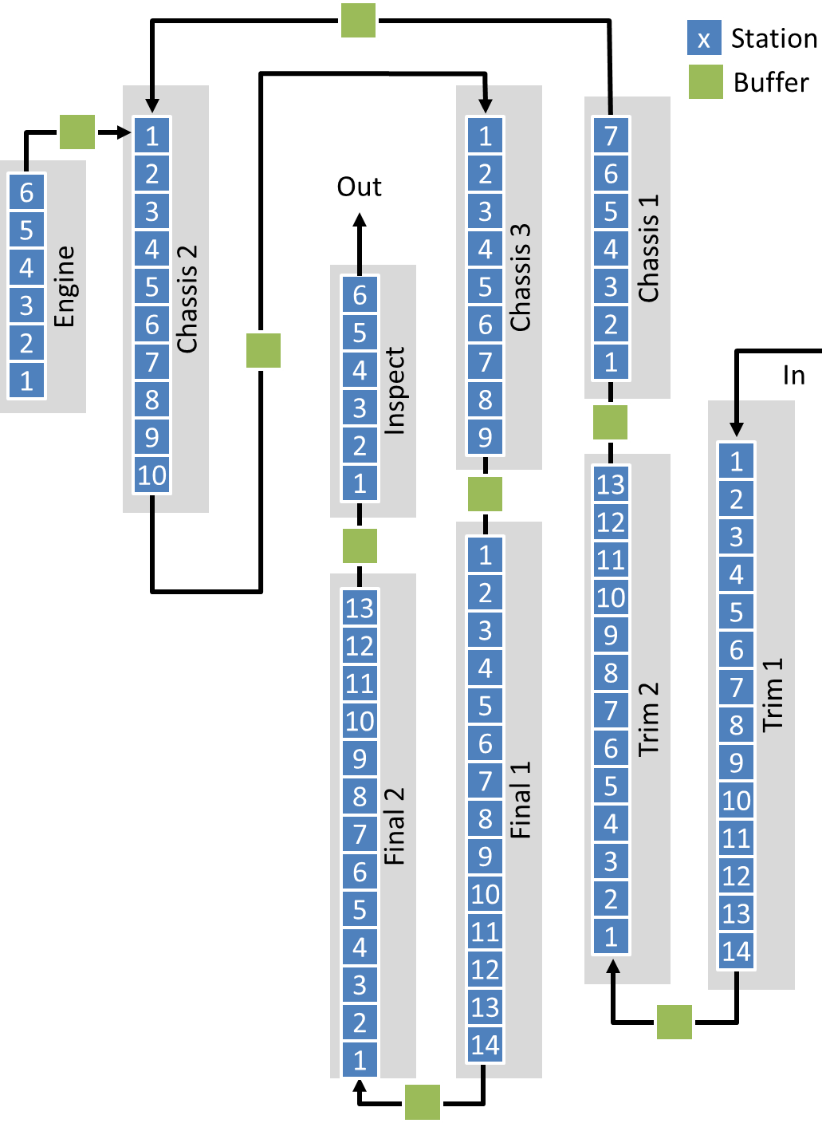
Overall Equipment Efficiency
Availability Uptime/Downtime Performances Fastest cycle Batch optimization Highest possible throughput Quality: Assembly / Scrap balance

Slide 13





Assembly Line and IIOT

Slide 14


Assembly Line and IIOT

Slide 15

Voltage Sensors

Slide 16

Temperature Sensors

Slide 17

Vibration Sensors

Slide 18
Vibration Sensors on conveyor belt

Slide 19

Proximity Sensors

Slide 20


Wireless Sensors
Edge Server / Gateway

Slide 21
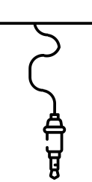


Industrial automation protocols wired Sensors
Data Acquisition System

Slide 22


Slide 25


Slide 26












Notes:
Key Message Font: Arial bold 36pt black Body Text Font: Arial 24pt black

Slide 27
02
03
Demo
Main title, Arial bold 36pt
Subtitle, Arial regular 24pt
Notes:
Number Font: Arial bold 180pt white Key Message Font: Arial bold 36pt white Body Text Font: Arial 24pt white

Slide 28
Manufacturing Plants
One Factory needs my immediate attention
Notes:
Title Font: Arial bold 24pt KN dark blue Map Body Text Font: Arial 18pt black
Map Colour: Accent Grey #5, 60% lighter Map Markers: KN Dark blue, light blue, light green and coral red
Change Map: You may swap the map for another you prefer from Frontify

Slide 29
Zoom on country level
MP1
Berlin
Anomaly reported
MP3
Bremen
MP2 Munich
Notes:
Main title font: Arial bold 24pt Dark blue
Number font: Arial bold 24pt white Text font: Arial 16pt white
Map location titles: Arial bold 14pt light blue Map location names: Arial bold 12pt black
Change the map and icons: You may swap the icons and map for ones you prefer in Frontify

Slide 30
Notes:
Key Message Font: Arial bold 36pt black Body Text Font: Arial 24pt black

Slide 34
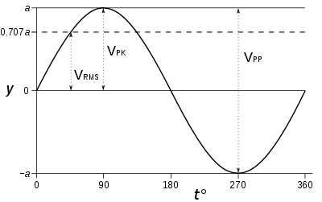
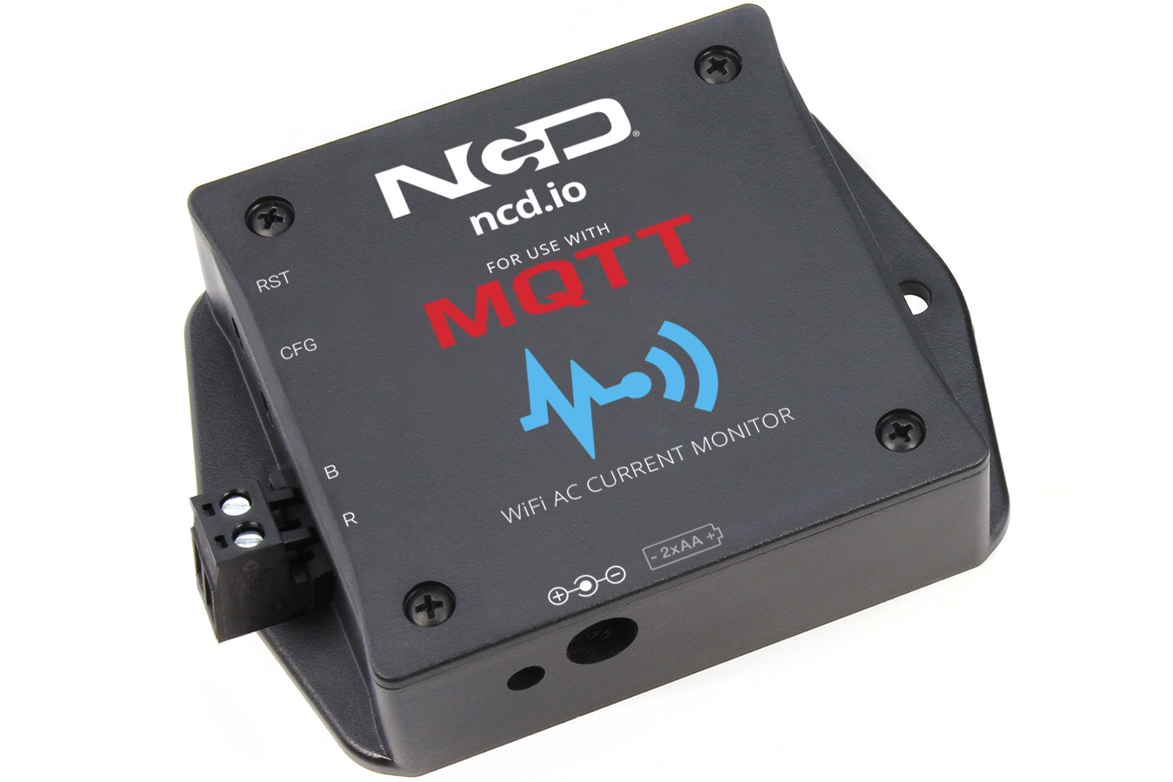
AC Voltage Sensor
Detects amperage from wires. Measure it at configurable intervals Send RMS of all measures at once.
Notes:
Root Mean Square

Slide 35
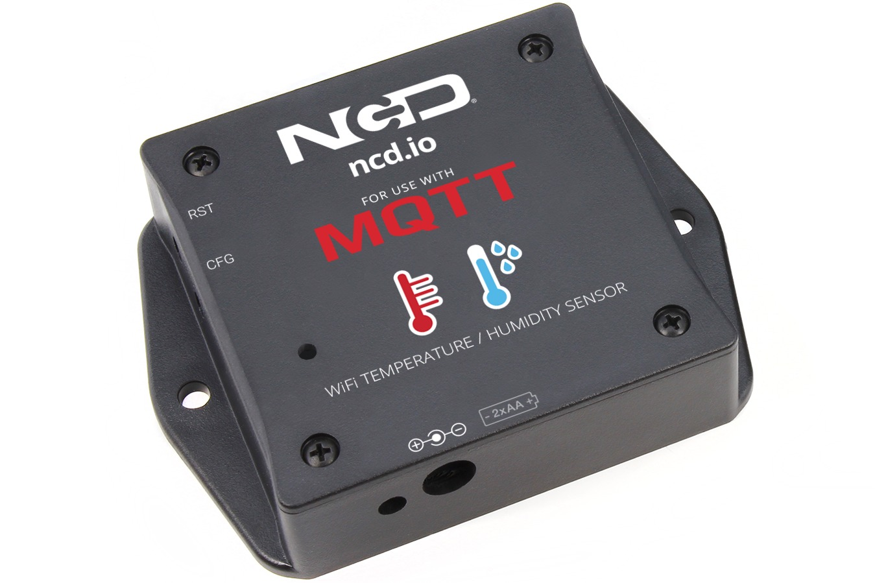
AC Temperature Sensor
Detects temperature of asset. Measure it at configurable intervals Send data to configured mqtt server.
Notes:
Root Mean Square

Slide 36
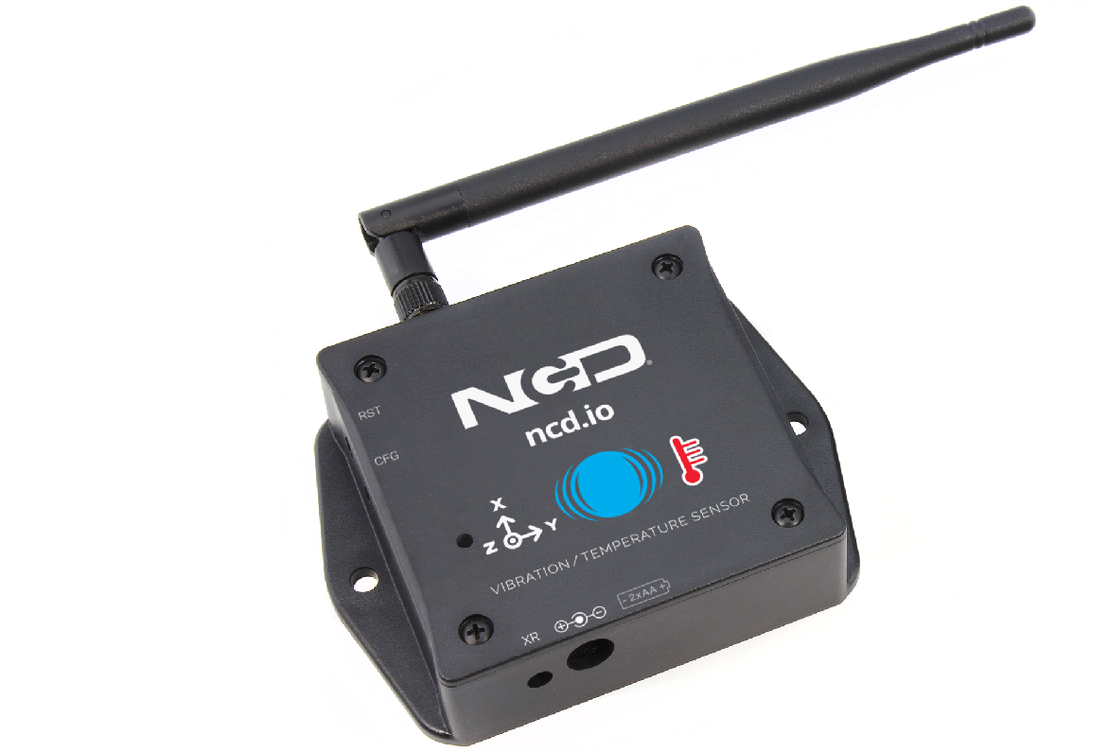
AC Vibration Sensor
Detects and measure vibration acceleration in g =(gravity acceleration) According to its documentation:
0.75g or More— Rough Condition, possible action required if machine is noisy and also check the bearing temperature
…
G. 2.5g or More — Shutdown the Machine and look for possible causes. Call a technician for immediate repair
For Heavy Machinery these readings could be 1.5 times to 2 times more.
Notes:
G = Gravitational force.

Slide 37
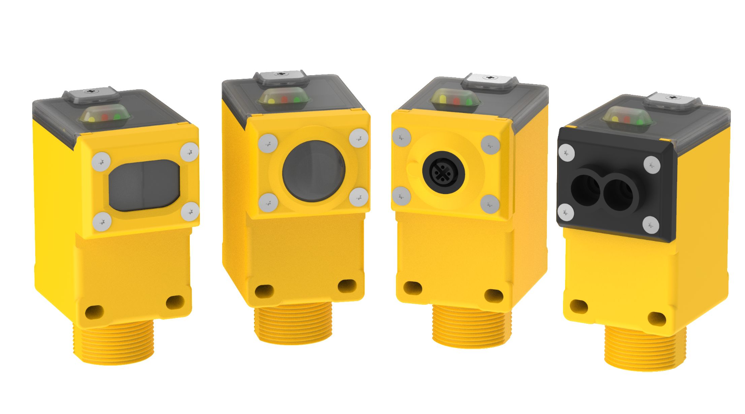
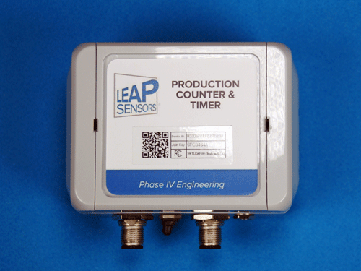
Proximity Sensor
Detect and count objects interrupting lights.
Send increments at configurable time intervals.
https://www.youtube.com/watch?v=yH0JCUwWq_M&ab_channel=BannerEngineering
Notes:
Root Mean Square

Slide 38
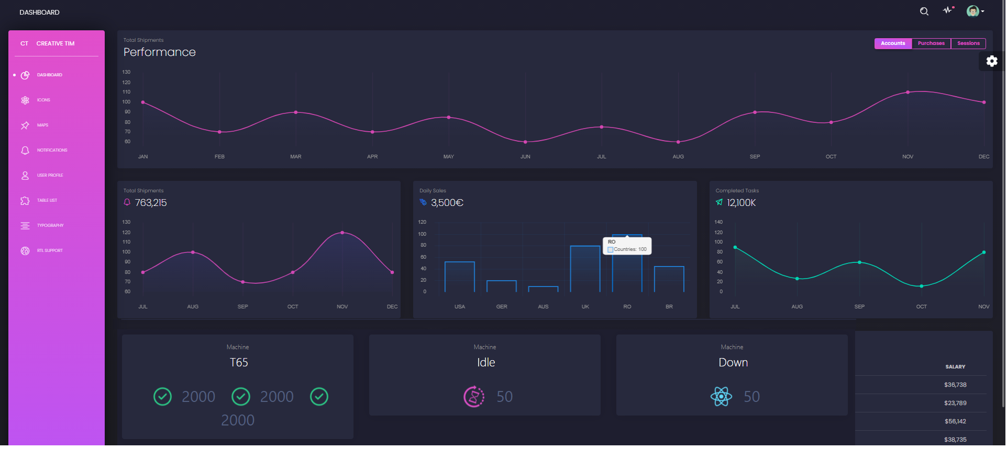
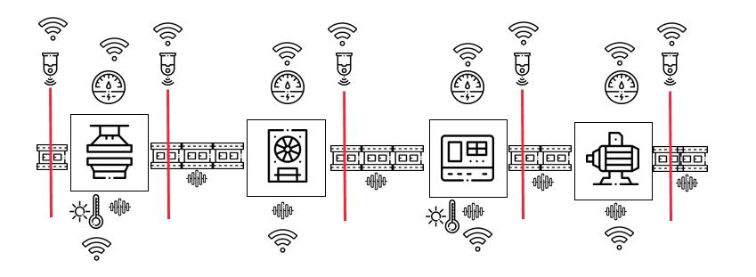

Software Architecture
Manufacturing Plant
Kn Hypersense
Cloud
Kn Hypersense Dashboard
Java
Mosquitto
Javascript/React

Slide 39

Software Architecture
Manufacturing Plant
Kn Hypersense
Cloud
Kn Hypersense Dashboard
Java
Mosquitto
Javascript/React

Slide 40
Software Architecture
Manufacturing Plant
Kn Hypersense
Cloud
Kn Hypersense Dashboard
MQTT
Java
Mosquitto
Javascript/React

Slide 41
Software Architecture
Manufacturing Plant
Kn Hypersense
Cloud
Kn Hypersense Dashboard
MQTT
Websocket
Java
Mosquitto
Javascript/React

Slide 42
Software Architecture
Manufacturing Plant
Kn Hypersense
Cloud
Kn Hypersense Dashboard
MQTT
Websocket
Java
Mosquitto
Javascript/React

Slide 43
Software Architecture
Manufacturing Plant
Kn Hypersense
Cloud
Kn Hypersense Dashboard
MQTT
Websocket
Java
Mosquitto
Javascript/React

Slide 44
Software Architecture
Manufacturing Plant
Kn Hypersense
Cloud
Kn Hypersense Dashboard
MQTT
Websocket
Java
Mosquitto
Javascript/React

Slide 45
Software Architecture
Manufacturing Plant
Kn Hypersense
Cloud
Kn Hypersense Dashboard
MQTT
Websocket
Java
Mosquitto
Javascript/React

Slide 46
Software Architecture
Manufacturing Plant
Kn Hypersense
Cloud
Kn Hypersense Dashboard
MQTT
Websocket
Java
Mosquitto
Javascript/React

Slide 47

Q&A

